Slide 1

Presentation for the proposed Android Project.
@Project Supervisor @Project Presented by,
Arafat Habib Quraishi. Partha Sarathi Kundu. | id: 1612020216
Senior Lecturer. MD Imran Hossain. | id: 1432020028
Member, Routine Committee, Department Of Computer Science & Engineering,
Computer Science & Engineering. Leading University, Sylhet, Bangladesh.

Slide 2
About The Project
Project Type: Education and Admission System.
Project Title: University Admission App.
Project Specification: All public university and admission information with automatic suggested university names to apply for the admission test.

Slide 3
Solution For The Problem.
Android Platform.
SQLite Database System.

Slide 4
Guardians
Guardian Name Contact Details University Type University Location
University Name Acronym University Type / Specialization University Location/ Address Year of Establishment Total Sits Total Students Website Address 2017- 2018 Admission Date
University
Details
Entity Relationship Diagram.
ER Diagram.
University
Requirements
University Name Acronym University Type / Specialization Total GPA from Science Group Total GPA from Humanities Group Total GPA from Business Studies Group
Student Name SSC & HSC or Equivalent Info Major Subjects for booth Exams Individual Result in GPA out of 5.00 Optional Subjects for booth Exams
Students

Slide 5
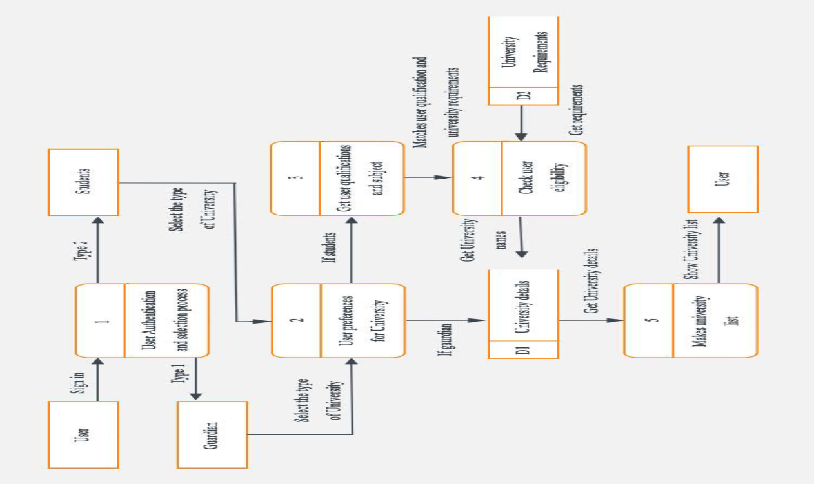
Complete Data Flow Data Diagram
(DFD).

Slide 6
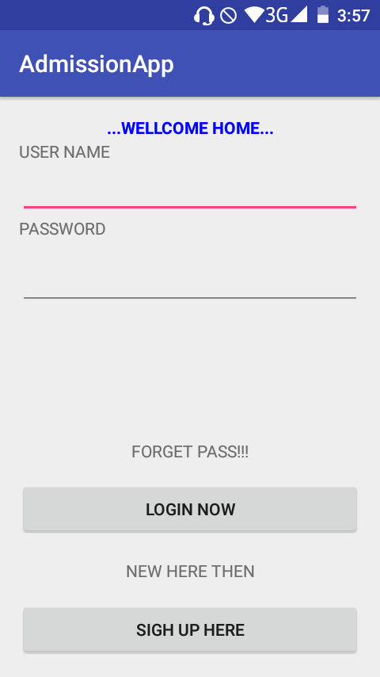
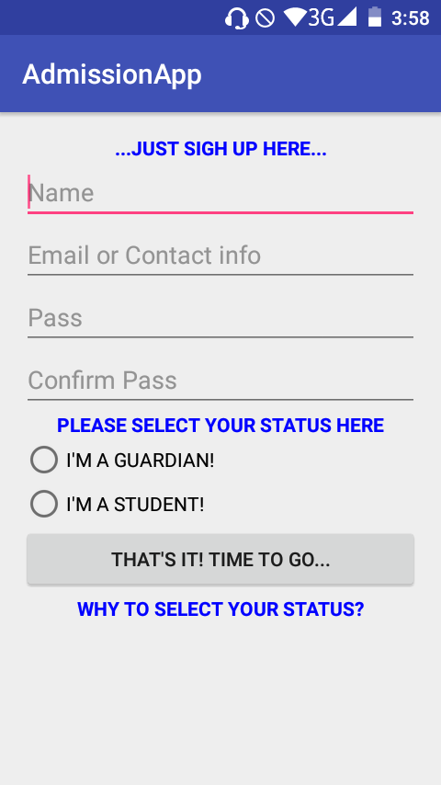
Application’s User Interface!
(UI)

Slide 7
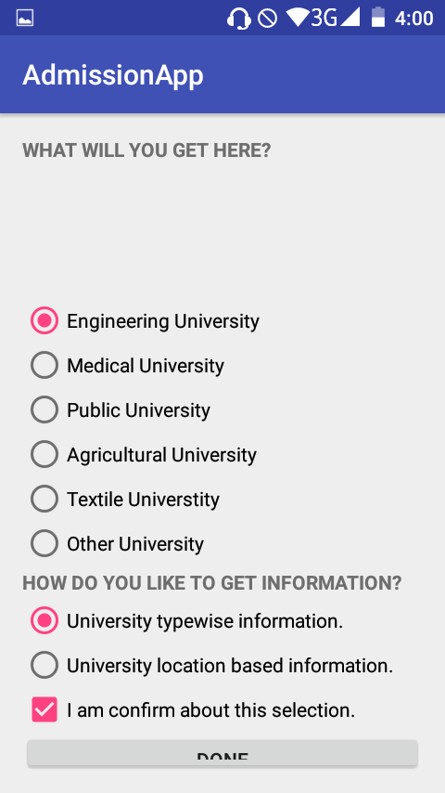
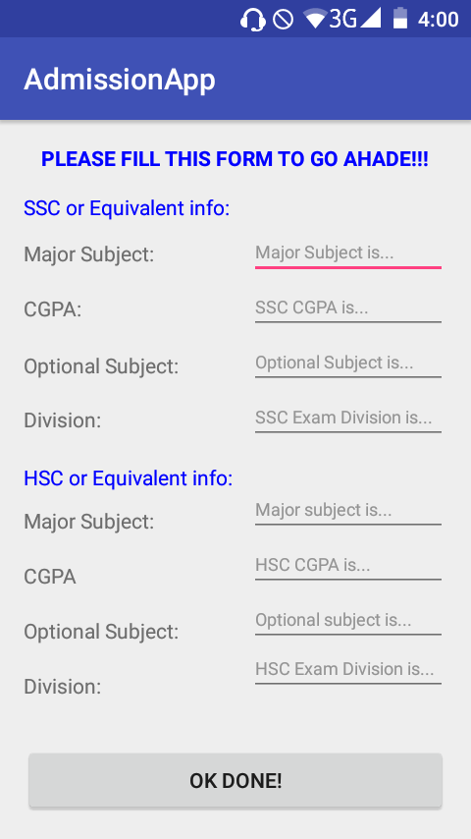
Application’s User Interface!
(UI)

Slide 8
Why Use University Admission app?
To know about the best chance of get admitted in public universities of Bangladesh. A Guardian and a student can get a lot of knowledge about public universities of Bangladesh.
It gives the suggestion about primary knowledge of the following universities admission preparation. Weak student can get knowledge about less competitive universities. The app will show the rank of the universities in Bangladesh.

Slide 9
Our Application & Features.
This combined product will cover up the following features:
Introducing the Universities of Bangladesh.
Picking up the interested students with the interested Universities to know about.
making our application more interactive more informative.
Students can get the best University names according to their qualification.
Guardians can get the University information in details.

Slide 10
Targeted Users & Why They’ll Use?
Targeted users: Our most valuable targeted users are students those who are just passed intermediate examination. All over we are targeting the students and the guardians.
Anyone who is intended to know the public University information and want to get benefited with the information to be sure which University is perfect for them for the admission examination.

Slide 11
Targeted Users & Why They’ll Use? (continued)
They’ll use our product because:
The students will get the most preferred university list according to their qualification.
The guardians and the students both will get the most up to date information about the universities of Bangladesh.
The extra time to decide which university to do admission exam will be saved.

Slide 12
Possible challenges and competitors
Challenges: On our project the main challenges is to maintain the information flow about the Universities cause we need to give the latest information to the students about the University admission examination. So here we need some promising authority to continue the program for the students.
Competitor: In our specified problem, we have no competitors as the play store has a little number of such application to support the students and the guardians.

Slide 13
Overcome the challenge
How to overcome ?: We believe that if anybody want to do great things then they must have to love what they are doing. So as we love the idea to support the students as well as the guardians and we are working on it.
We are better because we are working with the offline database system like SQLite where we are using predefined database for the information to be supplied to the students and the guardians.

Slide 14


